Slide 1
Workshop Prerequisites
Git (https://git-scm.com/), VirtualBox (https://www.virtualbox.org/) and Vagrant (https://www.vagrantup.com/) should be installed.
Run the following commands (you will be asked to open Jenkins and add the licence keys):
git clone https://github.com/cloudbees/training-books-ms.git
cd training-books-ms
vagrant up cje
vagrant ssh cje -c "chmod +x /vagrant/scripts/*"
vagrant ssh cje -c "/vagrant/scripts/preload_cje.sh"
vagrant halt
Notes:
The commands listed on this slide will pre-load all the packages and dependencies so that attendees do not need to waste time on it during the workshop.

Slide 2
CloudBees Jenkins Platform Pipeline with Docker
Welcome

Slide 3
Course Agenda
Day 1 | Pipeline 101
Day 2 | Docker 101
Day 3 | The Project – Part 1 Define the Project Create the Job
Day 4 | The Project – Part 2 Complete the Job Templates Jenkinsfile
Review and Resources

Slide 4
Pipeline 101 – In this Unit:
You Will Learn:
The Need For Pipeline
Pipeline Use Cases
Key Workflow DSL
Pipeline Structure and Syntax
Execution Control
You Will Be Able To:
Understand Pipeline Purpose And Use Cases
Understand Pipeline DSL And Syntax
Be Familiar With Plugins

Slide 5
Day 1 -- Timing
Topic | Duration | Time
Welcome | ??? | 0:00
Need For Pipeline | ??? | 0:00
What Is Pipeline? | ??? | 0:00
CD Pipeline
Pipeline Use Cases
Key DSL
Pipeline 101
Pipeline Structure and Syntax
Execution and Control
Review and Exercises

Slide 6
Pipeline with Docker Day 1
Pipeline 101
Notes:
The aim of the first day of the workshop is to introduce Pipeline on theoretical level (without hands-on). It will provide a short history of other plugins that lead to development of the Workflow, provide reasons for its existence and an introduction to its syntax.

Slide 7
The Need For Workflow?
Reduction of a number of jobs
Easier maintenance
Deployment decentralisation
Easier specification through code
Notes:
Reduction of a number of jobs:
When there are tens of jobs, their maintenance is quite easy. However, when that number increases to hundreds, managing them can become quite tedious and time demanding.
Let’s say that an average pipeline has five jobs (building, pre-deployment testing, deployment to a staging environment, post-deployment testing, and deployment to production). In reality, there are often more than five jobs but let’s keep it an optimistic estimate. If we multiple those jobs with, let’s say, twenty pipelines belonging to twenty different projects, the total number reaches one hundred.
Easier maintenance:
Now, imagine that we need to change all those jobs from, let’s say, Maven to Gradle. We can choose to start modifying them through the Jenkins UI or be brave and apply changes directly in Jenkins XML files that represent those jobs. Either way, this, seemingly simple change, would require quite some dedication. Fortunately, CloudBees Jenkins Enterprise Platform has templating functionality that simplifies massive modifications to multiple jobs.
Deployment decentralisation:
Even with it, maintaining many jobs chained into a pipeline is a complex endeavour. Moreover, due to its nature, everything is centralized in one location making it hard for teams to manage jobs belonging to their own projects.
Easier specification through code:
Some time ago, it become fashionable to use UIs for everything. We got a lot of tools that relied almost completely on drag&drop operations. Since then, we learned that there there should be a healthy division between the usage of UIs and code. Deployment pipeline is one of those cases when something is easier to express, and cheaper to maintain, when specified as code. Traditional Jenkins jobs proved to introduce unnecessary problems when dealing with complex pipelines, conditionals, and so on.

Slide 8
What is Jenkins Pipeline
CD is about setting a “pipeline”, from SCM commit to deployed application
Jenkins can chain jobs this way, but ...
Build
Test
Deploy
Notes:
The main requirement of continuous delivery (CD) is to set a "pipeline" that will run the whole process, starting from SCM commit, through building and testing, all the way until deployment. Jenkins has been capable of creating such a pipeline almost from the day it was born. However, being capable of doing something does not necessarily mean that something is done efficiently and easy to maintain. Jenkins had quite a lot of deficiencies preventing us from exploiting CD flow to its full potential. We can chain jobs but...

Slide 9
Jenkins CD pipeline
a real-world CD pipeline is way more complex !
requires (complex) conditional logic
requires resources allocation and cleanup
involves human interaction for manual approval
should be resumable at some point on failure
Notes:
A real-world CD pipeline is often much more complex than what chained jobs can offer. Even when we can accomplish the objectives, the result is cumbersome, hard to maintain, and difficult to visualise. Some of the CD objectives we are unable to solve through chained jobs or are proved to be difficult to implement, are as follows.
requires (complex) conditional logic:
CD pipelines often require some conditional logic to be applied. In many cases, it is not enough to simply chain jobs in a linear fashion. Often, we do not want to simply say run job A, once it's finished, run job B, and follow it with job C. In real-world situations, things are more complicated than that. We want to run something (call it A), depending on the result invoke B1 or B2, than run in parallel C1, C2, and C3, and, finally, execute job D only when C jobs are finished successfully. If this would be a program or a script, we would have no problem accomplishing something like that since all modern programming languages allow us to employ conditional logic in a simple and efficient way.
requires resources allocation and cleanup
Resource allocation needs a careful thought and, often, is more complicated than a simple decision to run a job on a predefined slave. There are cases when slave should be decided dynamically, workspace should be defined during runtime, and cleanup depends on a result of some action.
involves human interaction for manual approval
While continuous deployment process means that the whole pipeline ends with deployment to production, many business are not ready for such a scope, or have use cases when it is not appropriate. Any other process with a smaller scope, be it continuous delivery or continuous integration, often requires some human interaction. A step in the pipeline might need someone's confirmation, failed process might need a manual input about reasons for the failure, and so on. Requirement for human interaction should be an integral part of the pipeline and should allow us to pause, inspect, and resume the flow.
should be resumable at some point on failure
In many cases, it can take a long time for deployment pipelines to be fully executed. It is not uncommon for them to run for a couple of hours, or even days. In such cases, failure of the process, or the whole node the process is running on, should not mean that everything should be repeated. We should have a mechanism to continue the flow from defined checkpoints thus avoiding costly repetition, potential delays, and additional costs.

Slide 10
Jenkins CD pipeline
many related plugins
conditional build steps
parameterized trigger
promotions
...
Major issue : pipeline configuration is scattered in various jobs
Notes:
Jenkins already had plugins that could help us designing and building CD pipelines. We got "Conditional build steps", "Parameterised trigger", "Promotions", and so on. One of the major issues with those plugins is configuration. It tends to be scattered across multiple locations, hard to maintain, and with low visibility.

Slide 11
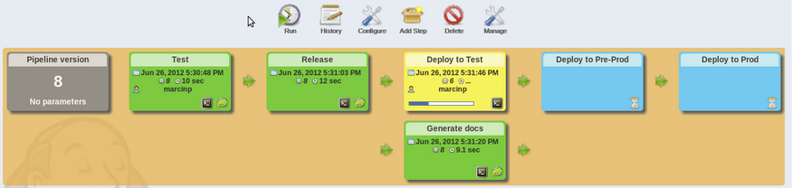
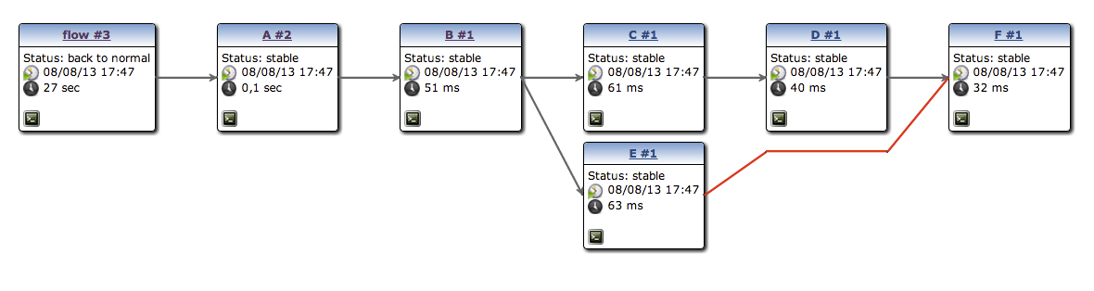
CD pipeline visualization
pipeline plugin to render “linear” pipeline
build-graph-view to render complex ones
Notes:
The "Build Pipeline" plugin helps us in visualisation of the process but failed to address any other need of the CD flow.

Slide 12
Reality
Check
How Do You Use Jenkins Or Workflow Now?
Given The Functionality, Where Do You See Your Team Using These Tools And Plugins In Your Jobs?
Do you practice CI or CD?
Describe your CI/CD flow needs and processes.

Slide 13
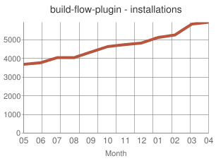
build-flow plugin
OSS
Proof of concept
Define CD pipeline as code
Largely adopted
Technical limitations
Notes:
OSS:
During mid. 2012, the first beta version of the Build Flow Plugin has been released as open source.
Proof of concept:
More than a final solution to CD flow problems, it was considered a proof of concept.
Define CD pipeline as code:
The main idea behind the plugin was to define the CD pipeline through code. To simplify coding, Groovy based DSL was created.
Largely adopted:
The response from the community was very positive and the plugin received a wide adoption that demonstrated that the direction of the plugin was correct and should be explored more.
Technical limitations:
The plugin hit some technical limitations that prevented the community from developing it further. We had to start fresh using the knowledge and experience obtained through the Build Flow plugin. As a consequence, the Workflow plugin was born and, later, renamed to the Pipeline plugin.

Slide 14
CloudBees Pipeline Plugin
inspired by build-flow
Groovy DSL to orchestrate build steps (optionally jobs)
extensible DSL syntax
do supports checkpoints
advanced visualization
plain text : Can be stored in SCM
Notes:
Visiualization is available only in the enterprise edition, no Team (opensource).
Also enterprise only is Check.points

Slide 15
Groovy DSL ?
Groovy based “Domain Specific Language” to manage build step orchestration
Groovy is widely used in Jenkins ecosystem. You can leverage on Groovy experience
If you don’t like/care about Groovy, just consider the DSL as a dedicated simple syntax
Notes:
Need to have very little Groovy knowledge. Just be able to identify and coopy/past code snippets etc.
Lots of flex, little coding needed. Can also store you code and workflow esigns

Slide 16
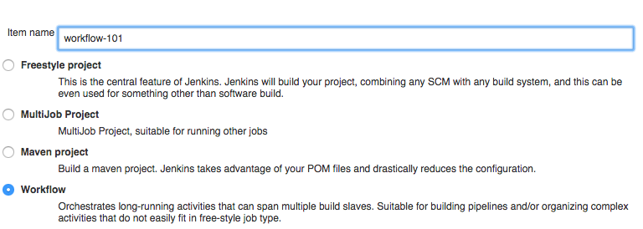
Workflow 101
a Workflow is a new type of job
Notes:
Step 1 – create new workflopw

Slide 17
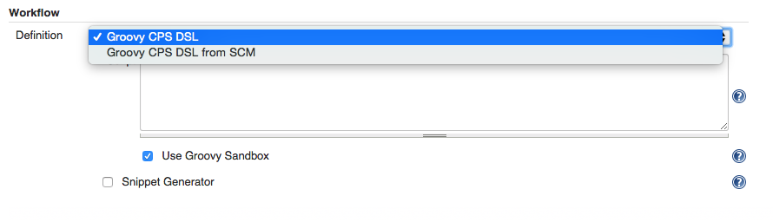
Workflow 101
Can define DSL in jenkins, or store in SCM
=> possibly distinct workflow per branch
no need to be an administrator
no need to know groovy or DSL syntax
Notes:
SCM = source control manager
Tick Snippet Generator to limit need for Groovy.

Slide 18

MID - BREAK
10 minutes for learner re-integration.
Instructor will return early for comments or questions.
Re-commence at ______ (time).

Slide 19
Workflow Structure and Syntax

Slide 20
Workflow 101 - basic DSL syntax
DSL is used to define when/how to run build steps
those (most of them) will run on a node, i.e. a build executor
node('slave') { sh 'echo hello world' }
DSL keyword to run a shell script build step
Notes:
“node” doesn’t exist in Groovy – it is a DSL

Slide 21
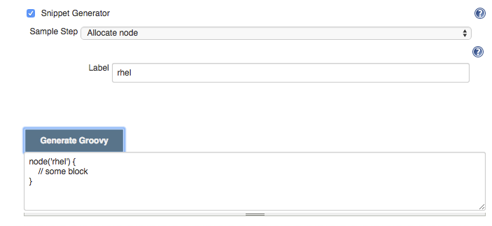
Workflow Snippet Generator
No need to learn DSL syntax !
Notes:
First line of groovy script.
Using Groovy sandbox and this snippet generator makes this as easy as possible.

Slide 22
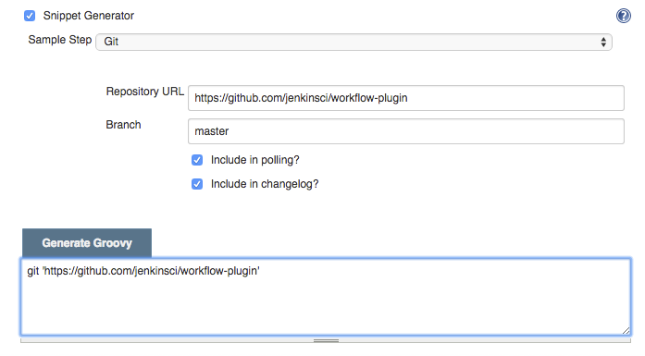
Workflow 101 - build steps
Some have native DSL support
Notes:
Snippet wiz creates the groovy for you

Slide 23
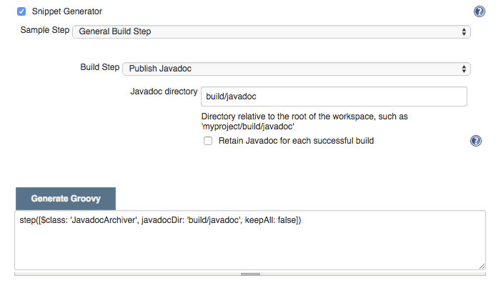
Workflow 101 - build steps
Some don’t (yet) have native DSL support and require some hack-ish invocation syntax - but still work

Slide 24
Workflow with Docker Day 1
Review
Notes:
The aim of the first day of the workshop is to introduce workflow on theoretical level (without hands-on). It will provide a short history of other plugins that lead to development of the Workflow, provide reasons for its existence and an introduction to its syntax.

Slide 25
Day 1 Review

Slide 26
Workflow with Docker Day 1
Exercise
Notes:
The aim of the first day of the workshop is to introduce workflow on theoretical level (without hands-on). It will provide a short history of other plugins that lead to development of the Workflow, provide reasons for its existence and an introduction to its syntax.

Slide 27
Day 1 – Exercise
"
Notes:
To reinforce today’s material we have a short exercise for you.
Before our next session, please perform the following:
EXERCISE CONENT

Slide 28
Workflow with Docker Day 2
Docker 101
Notes:
This day is dedicated to a practical introduction to Docker and the tools around it.

Slide 29
Prepare the Environments
vagrant up cje
vagrant ssh cje -c "/vagrant/scripts/provision_docker.sh"
Notes:
The first command will create the VM. The second command will setup everything required for today's session: Docker, Docker Compose, and Docker Registry.

Slide 30
Review Of Day 1 Concepts And Exercise

Slide 31
Docker Containers
Self-sufficient
Isolated
Immutable
Reliable
Scalable
Notes:
Traditional deployments would put an artifact into an existing node expecting that everything else is in place; the application server, configuration files, dependencies, and so on. Containers, on the other hand, contain everything our software needs. Each container should be self-sufficient. It should contain everything an application needs. That includes, but is not limited to, run-time dependencies, built artefacts (JARs, WARs, DLLs), application server, and so on.
Each container runs in an isolated process thus making it more fault-tollerant, easier to deploy and more secure.
Containers consist of a number of unchangeable images making them immutable thus avoiding differences that might between different environments. Applications packed inside containers behave exactly the same no matter whether they are deployed to developer laptop, staging server, or production.
When isolation, self-sufficiency, and immutability are combined, the result is higher reliability.
Since each container is immutable, scaling an application is much easier than when other packaging and deployment methods are used.

Slide 32
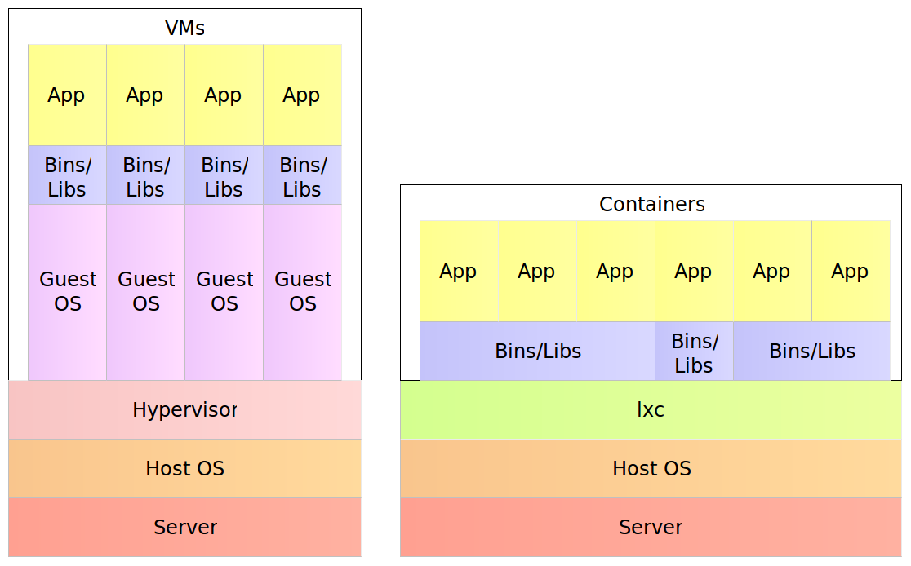
Docker Containers
Notes:
A physical server running, for example, five virtual machines would have five operating systems in addition to a hypervisor that is more resource demanding than lxc. Five containers, on the other hand, share the operating system of the physical server and, where appropriate, binaries and libraries. As a result, containers are much more lightweight then VMs. That is not such a big difference with monolithic applications especially in cases when a single one would occupy the whole server. With microservices, this gain in resource utilization is very important considering that we might have tens or hundreds of them on a single physical server. Put in other words, a single physical server can host more containers than virtual machines.

Slide 33
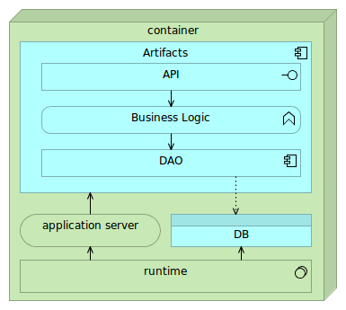
Single-Container Service
Notes:
Containers are self-sufficient bundles that contain everything we need (with the exception of the kernel), run in an isolated process and are immutable. Being self-sufficient means that a container commonly has the following components. * Runtime libraries (JDK, Python, or any other library required for the application to run) * Application server (Tomcat, nginx, and so on) * Database (preferably lightweight) * Artifacts (JAR, WAR, static files, and so on)

Slide 34
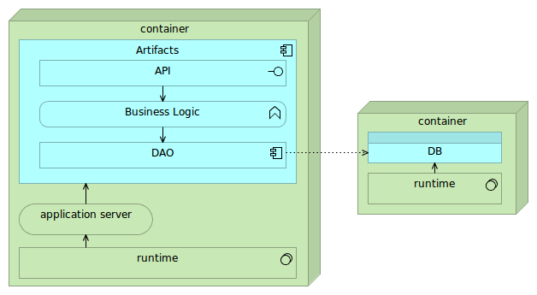
Linked or Networked Containers
Notes:
Fully self-sufficient containers are the easiest way to deploy services but pose a few problems with scaling. If we'd like to scale such a container on multiple nodes in a cluster, we'd need to make sure that databases embedded into those containers are synchronized or that their data volumes are located on a shared drive. The first option often introduces unnecessary complexity while shared volumes might have a negative impact on performance. Alternative is to make containers almost self-sufficient by externalizing database into a separate container. In such a setting there would be two different containers per each service. One for the application and the other for the database. They would be linked (preferably through a proxy service). While such a combination slightly increases deployment complexity, it provides greater freedom when scaling. We can deploy multiple instances of the application container or several instances of the database depending performance testing results or increase in traffic. Finally, nothing prevents us to scale both if such a need arises.

Slide 35
Docker Use Cases
Local development and testing
Continuous integration, delivery, or deployment
Reliable and repeatable deployments from development to production environments
Notes:
Due to containers self-sufficiency and immutability, setting up local environment poses no effort and the result is exactly the same no matter whether they are run on laptops or servers. Running a full application requires a single command through Docker CLI. A whole system can be defined in a single Docker Compose configuration reducing deployment of any number of services a breeze.
Since there is no need to provision environment (except Docker engine itself), CI/CD is much simplified especially setting up nodes where testing and building will be performed.
Having a guarantee that a container will behave in the same way no matter the environment, deployments are more reliable since we know that the application tested in, for example, staging environment, will behave the same when deployed to production.

Slide 36
Docker Tools
Docker Hub/Registry
Docker Engine
Docker Compose
Docker Swarm
Docker Machine
Kinematic

Slide 37
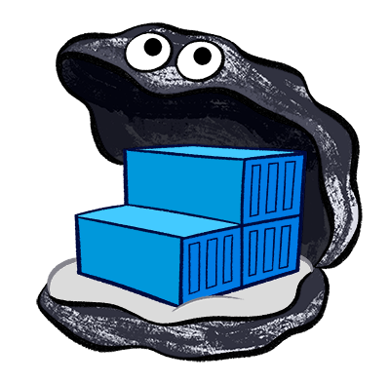
Docker Hub and Registry
Docker Hub is a cloud hosted service from Docker that provides registry capabilities for public and private content.
Docker Trusted Registry allows you to store and manage your Docker images on-premise or in your virtual private cloud to support security or regulatory compliance requirements in keeping data and applications your infrastructure.
Docker Registry is an open source application dedicated to the storage and distribution of your Docker images.

Slide 38
Docker Hub/Registry
$ vagrant ssh cje
$ docker pull cloudbees/training-books-ms-tests
$ docker tag -f cloudbees/training-books-ms-tests 10.100.198.200:5000/training-books-ms-tests
$ docker push 10.100.198.200:5000/training-books-ms-tests
Notes:
Enter the VM
Demonstrate pulling of a container from Docker Hub.
Demonstrate tagging of a container with a name in the format [PRIVATE_REGISTRY_IP_PORT]:[CONTAINER_NAME]. This format is required in order to push images to the private registry.
Push the container to the private registry

Slide 39
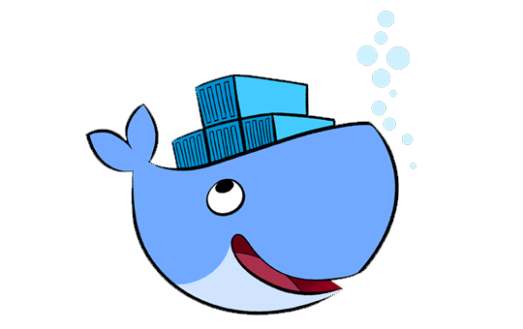
Docker Engine
Docker Engine is a lightweight runtime and robust tooling that builds and runs Docker containers.

Slide 40
Docker Engine - Running Containers
$ cd ~/training-books-ms
$ docker run -it --rm \
-v $PWD/client/components:/source/client/components \
-v $PWD/client/test:/source/client/test \
-v $PWD/src:/source/src \
-v $PWD/target/scala-2.10:/source/target/scala-2.10 \
--env TEST_TYPE=all \
10.100.198.200:5000/training-books-ms-tests
$ ll target/scala-2.10/
$ docker ps -a | grep books
Notes:
The books-ms-tests is a demonstration of the power of Docker containers. It is a container that runs front-end and back-end tests and, if they are successful, compiles the code.
Ask the audience how much time it would take to setup an environment with the following:
MongoDB
NodeJS
Git
SBT
FireFox
Chrome
Scala
Gulp
Bower
Once they answer, ask them how much more time it would require to setup the process that runs front-end and back-end tests, compile the back-end code into a JAR and minifies the front-end code.
Finally, ask the audience how many problems we would have if there would be many
Proceed with the commands to show them how easy it is to do all that with an
Enter the directory with the books-ms service code.
Run the tests. Make sure to explain what is happening by evaluating the output. The command will do the following.
Run Mongo DB
Run Back-end tests
Shut down Mongo DB
Run front-end tests using FireFox (optionally it can use Chrome as well since it is already inside the container)
Compile the code
The arguments are as follows:
-it: Makes the container interactive with a terminal
--rm: Removes the container when the process running inside it is finished.
-v: Mounts a volume between the host and the container. In this case, we're using it to mount the source code directories inside the container
--env: Sets environment variables. In this case, we're using it to tell the code what type of tests to run.
List the contents of the directory in order to demonstrate the end result of the previous command (JAR file)
List all Docker processes and demonstrate that the container is completely gone as if it never existed.

Slide 41
Docker Engine - Building Containers
$ cat Dockerfile
$ docker build -t 10.100.198.200:5000/training-books-ms .
$ docker push 10.100.198.200:5000/training-books-ms
Notes:
Display Dockerfile and walk them through the definition.
FROM: Tells Docker what to use as a base image (in this case Debian). Explain that it is not a full Debian distribution but the absolute minimum for the rest of the instructions to run (for example apt-get). Docker uses host kernel so there is no need for the full Linux OS inside a container.
MAINTAINER: Informational only
RUN: Runs a command in the same way we'd run it through shell. In this case, it updates the system, installs JDK7, and, finally, performs some cleanup. Explain why multiple commands are grouped together (images, immutability, keeping the container small)
ENV: Sets a couple of environment variables used by the service. Those are default values that can be changed at runtime. Explain that environment variables are a preferred way to pass some custom values to a container and why that is better than dealing with configuration files.
COPY: Copies a file of a directory from the host to the container image.
CMD: Command that will be run when container is started.
EXPOSE: Port that will be exposed. Explain that the internal and the external port numbers do not need to be the same and why it is best if Docker exposes a random port.
Build the container using the format that allows us to push it to the private registry. Explain the usage of cache and the importance of having Dockerfile instructions in the correct order.
Push the container to the private registry

Slide 42
BREAK

Slide 43
Docker Engine - Running Containers
$ docker run -d --name books-ms-db mongo
$ docker run -d --name books-ms \
-p 1234:8080 \
--link books-ms-db:db \
10.100.198.200:5000/training-books-ms
$ docker exec -it books-ms env | grep DB
$ docker ps
$ curl -I localhost:1234/api/v1/books
Notes:
The service itself needs to containers running; the service itself (books-ms) and the MongoDB.
Run the service DB. Notice that no port was exposed and explain why (tip: linking).
Run the service.
-d: Container will run in detached mode.
--name: A name we're giving to this container. If not specified, Docker will assign it a random name. Explain that each container has a unique ID besides the name.
-p: Internal port 8080 will be exposed as 1234
--link: The container will be linked with the service DB. The first value is the name of the container we're linking with and the second is the name we assign to that link. Explain that linking is useful as a quick demonstration but that it has been deprecated in favour of SDN.
Execute a process inside the specified container (in this case books-ms). In this case, it will list all environment variables containing DB. This is a demonstration not only of the exec command but also what is generated by Docker when we link containers.
List all running Docker processes
Send a request to the service to demonstrate that everything is working correctly

Slide 44
Docker Engine - Logs, Processes, Stopping and Removing
$ docker logs books-ms
$ docker logs books-ms-db
$ docker ps
$ docker stop books-ms-db books-ms
$ docker ps -a
$ docker rm books-ms-db books-ms
$ docker ps -a
Notes:
Display logs of the service container. Explain what would happen if -f is used.
Display logs of the DB container.
Display running processes (both the service and the DB containers should be running)
Stop both the service and the DB containers
Display all processes (both the service and the DB containers should be in the Exit state)
Remote containers
Display all processes (both the service and the DB containers should not exist)

Slide 45

Docker Compose
Docker Compose allows defining multi-container application with all of its dependencies in a single file, then spin your application up in a single command.

Slide 46
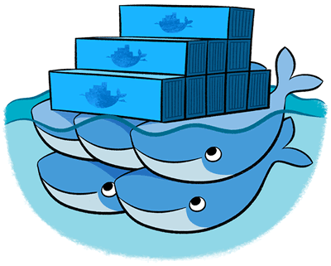
Docker Swarm
Docker Swarm provides native clustering capabilities to turn a group of Docker engines into a single, virtual Docker Engine. With these pooled resources, you can scale out your application as if it were running on a single, huge computer.

Slide 47
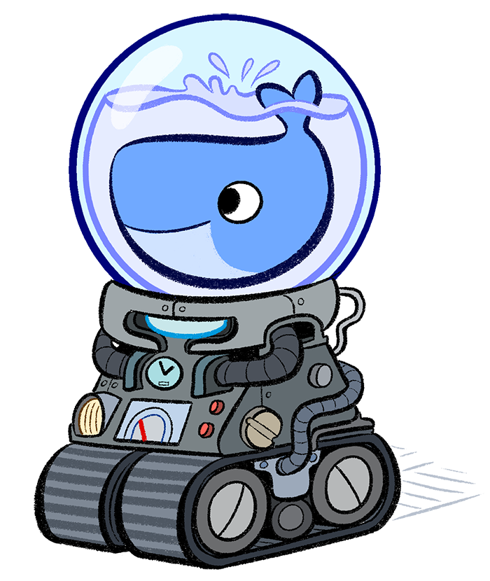
Docker Machine
Docker Machine automatically sets up Docker on your computer, on cloud providers, and inside your data center. Docker Machine provisions the hosts, installs Docker Engine on them, and then configures the Docker client to talk to the Docker Engines.

Slide 48
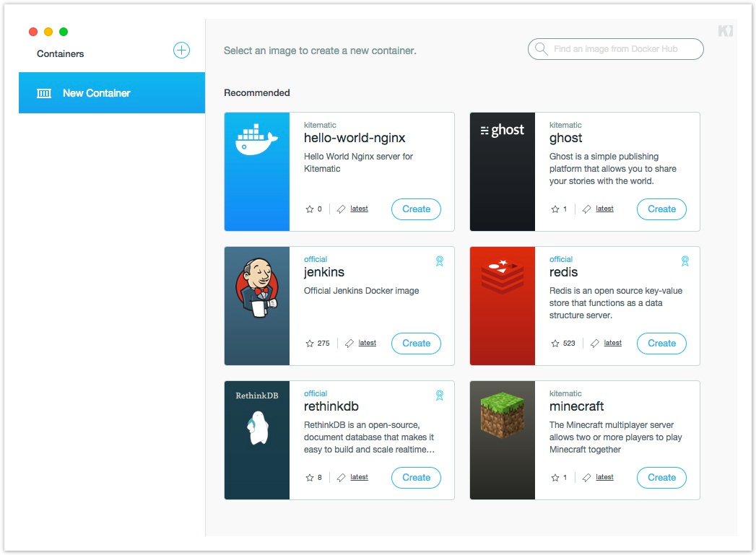
Kitematic
Kitematic is a completely automated process that installs and configures the Docker environment on your machine. Build and run containers through a simple, yet powerful graphical user interface (GUI).

Slide 49
Cleanup
$ exit
$ vagrant halt

Slide 50
Workflow with Docker Day 3
The Project Part 1

Slide 51
Prepare the Environments
vagrant up cje
vagrant ssh cje -c "/vagrant/scripts/provision_cje.sh"
Notes:
The first command will create the VM. The second command will setup everything required for today's session: Java, Docker, Docker Compose, Docker Registry, CJE, and Jenkins node. Once CJE is up and running, participants will be asked to open it in a browser, enter the licence key and go back to the terminal screen to continue the setup. CJE will be fully set up with nodes, sample jobs, and so on.

Slide 52
The Project
Run pre-deployment tests (unit tests, functional tests, and so on) inside a Docker container
Build artefacts (JAR, WAR, DLL, and so on)
Build the service container
Request manual permission to deploy the service container to production
Pull the service container and all dependent containers to production
Run the service container and all dependent containers in production
Run post-deployment tests (integration tests) inside a Docker container
Notes:
The idea behind today's and tomorrow's sessions is to learn basics about Jenkins Workflow and Docker Workflow plugins.

Slide 53
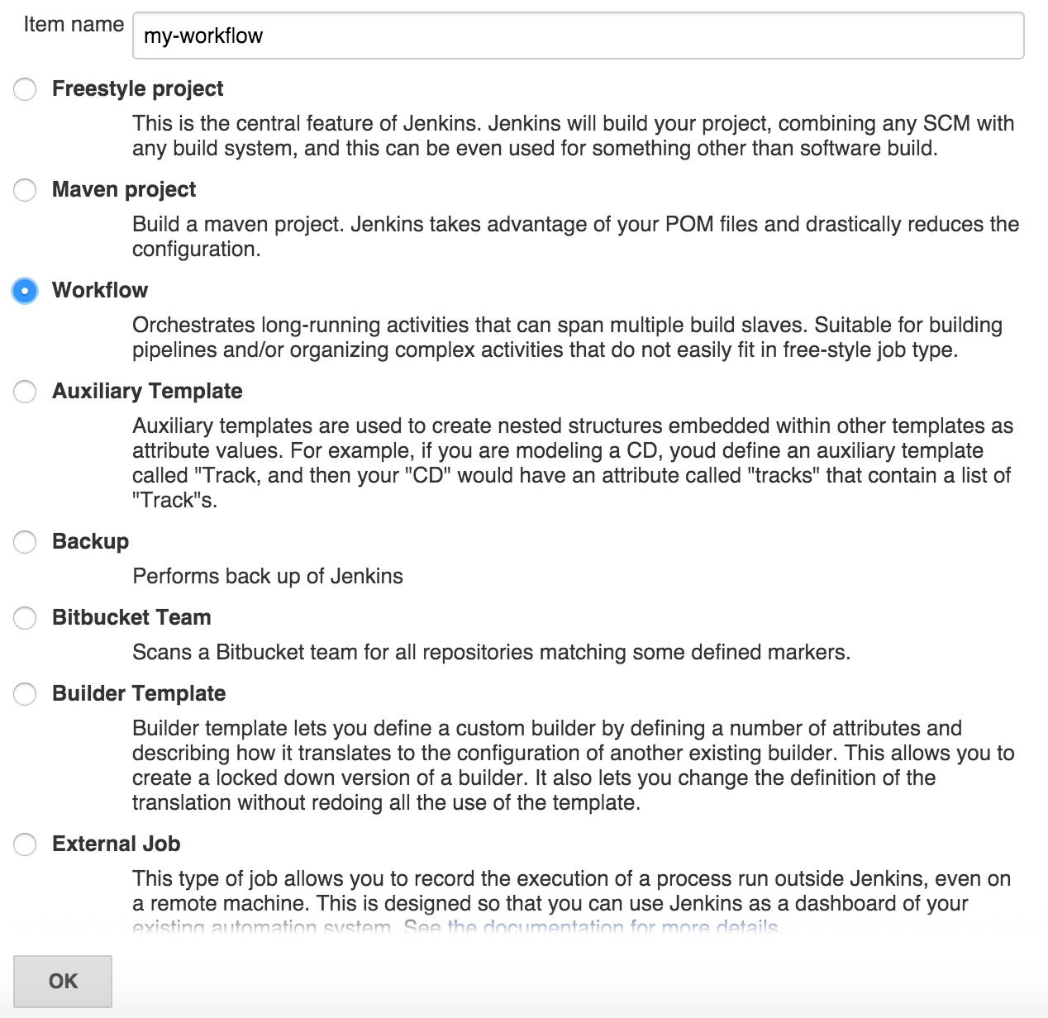
Create a Workflow Job
Notes:
A new Workflow job can be created by clicking the "New Item" link from the left-hand menu, typing a name of the job, selecting "Workflow" as type and clicking the "OK" button. For this exercise, please use "my-workflow" as the job name.

Slide 54
Key Workflow DSL – node
Task:
Specify the node cd, run the workflow and confirm that it is running inside the cd node by looking at logs.
node("cd") {
}
Notes:
A node is a step that schedules a task to run by adding it to the Jenkins build queue. As soon as an executor slot is available on a node (the Jenkins master, or a slave), the task is run on that node. A node also allocates a workspace (file directory) on that node for the duration of the task (more on this later). The argument inside brackets can be used to define the name of the node or label. In this case, the code inside this node will run only on those named or with the label "cd".
To see all the available arguments, please click the "Snippet Generator" checkbox and select the "node" step. To generate the Groovy code, please write "cd" in the "Label" field and click the "Generate Groovy" button. Generated code can be copy&pasted into the "Script" text box. Same process should be followed for the rest of exercises.

Slide 55
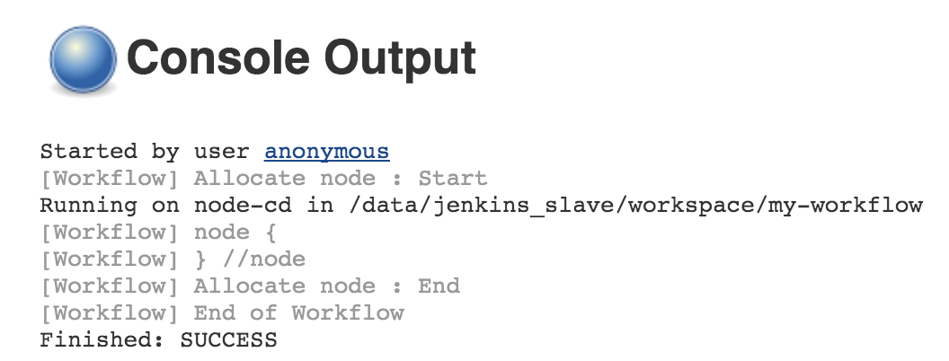
Run the Job
Open http://10.100.198.200:8080/job/my-workflow/build?delay=0sec
Open http://10.100.198.200:8080/job/my-workflow/lastBuild/console
Notes:
Workflow jobs are run as any other type of Jenkins jobs. Click the "Build Now" link in the left-hand menu when inside the job screen or open the first URL presented on the screen. Let's take a look at the console output of the build (the second URL). Not much happened since we haven't specified any instruction to be run inside the node. The important thing to note is that we can see from the output that the job was run inside the "node-cd" node. The node is configured with the"cd" label.

Slide 56
Key Workflow DSL – git
Task:
Clone the code from the repository https://github.com/cloudbees/training-books-ms.git
git "https://github.com/cloudbees/training-books-ms.git"
Notes:
Git step. It performs a clone from the specified repository.

Slide 57
Key Workflow DSL – variables, pwd and sh
Task:
Assign current job workspace directory to the dir variable, create directory db inside the workspace and assign full permissions to all users.
def dir = pwd()
sh "mkdir -p ${dir}/db"
sh "chmod 0777 ${dir}/db"
Notes:
Variables have the same function as in any other programming or scripting language. In addition, all job parameters are available as Workflow variables. Inside a string, variable values can be obtained using the same syntax as in bash scripts by prefixing them with the dollar sign. Curly braces are optional.
The "pwd" function returns the current directory path as a string.
The "sh" runs a Bourne shell script on a Unix node. Multiple lines are accepted. An interpreter selector may be used, for example: "#!/usr/bin/perl". We can use it to create the directory by running "mkdir" and assign permissions with "chmod".

Slide 58
Key Workflow DSL – stage
Task:
Create the pre-deployment tests stage.
stage "pre-deployment tests"
Notes:
By default, flow builds can run concurrently. The stage command lets you mark certain sections of a build as being constrained by limited concurrency. Newer builds are always given priority when entering such a throttled stage; older builds will simply exit early if they are preempted. Stage is also used inside the "Stage View" as a way to separate the flow into groups.

Slide 59
BREAK

Slide 60
Key Workflow DSL – docker
Task:
Pull the Docker image 10.100.198.200:5000/books-ms-tests and run the run_tests.sh script inside the container. Host volume db should be shared with /data/db inside the container.
def tests = docker.image("10.100.198.200:5000/training-books-ms-tests")
tests.pull()
tests.inside("-v ${dir}/db:/data/db") {
sh "./run_tests.sh"
}
Notes:
Docker image we want to work with can be specified with "docker.image('FULL_IMAGE_NAME')". It will return a reference that can be stored as a variable. Images can be pulled from Registry using ".pull()". Use ".inside" to run instructions inside a container. The "inside" function accepts arguments that will be passed to Docker. For example, we can specify volume like "-v HOST_VOLUME_PATH:DOCKER_VOLUME_PATH".

Slide 61
Key Workflow DSL – docker
Task:
Build the Docker image 10.100.198.200:5000/books-ms and push the container to the private registry. Use the stage build for these steps
stage "build"
def service = docker.build "10.100.198.200:5000/training-books-ms"
service.push()
Notes:
Building an image can be done with ".build" followed by the image name. The result can be assigned to a variable. Similarly, image can be pushed through ".push()".

Slide 62
Key Workflow DSL – stash and unstash
Task:
Pull containers and run (through Docker Compose target app) the 10.100.198.200:5000/books-ms container in the production node. Use stash to archive docker-compose-dev.yml file while in the cd node and unstash to retrieve it when inside the production node. Before running the service, make sure that both the service and mongo containers are pulled.
node("cd") {
...
stash includes: "docker-compose*.yml", name: "docker-compose"
}
node("production") {
stage "deploy"
unstash "docker-compose"
docker.image("10.100.198.200:5000/training-books-ms").pull()
docker.image("mongo").pull()
sh "docker-compose -p books-ms up -d app"
}
Notes:
If multiple nodes are used inside the same Workflow, in some cases there is the need to move files from one to another. The "stash" instructions stores some files to be used later in the build. Its counterpart is "unstash" that restores stashed files.

Slide 63
Key Workflow DSL – env and withEnv
Task:
Run post-deployment tests in the node cd. The run_tests.sh script expects two environment variables: TEST_TYPE=integ and DOMAIN=http://10.100.199.201:8081. Tests should be run inside the training-books-ms container.
node("cd") {
stage "post-deployment tests"
def tests = docker.image("10.100.198.200:5000/training-books-ms-tests")
tests.inside() {
withEnv(["TEST_TYPE=integ", "DOMAIN=http://10.100.198.200:8081"]) {
sh "./run_tests.sh"
}
}
}
Notes:
Environment variables can be assigned or retrieved using the "env" instruction. The "withEnv" instruction sets one or more environment variables within a block. It is a very useful feature that allows us to limit the scope of environment variables.

Slide 64
Cleanup
$ exit
$ vagrant halt

Slide 65
REVIEW Day 3 and PREP

Slide 66
Workflow with Docker Day 3
The Project Part 2

Slide 67
Prepare the Environments
vagrant up cje
vagrant ssh cje -c "/vagrant/scripts/provision_cje.sh"
Notes:
The first command will create the VM. The second command will setup everything required for today's session: Java, Docker, Docker Compose, Docker Registry, CJE, and Jenkins node. Once CJE is up and running, participants will be asked to open it in a browser, enter the licence key and go back to the terminal screen to continue the setup. CJE will be fully set up with nodes, sample jobs, and so on.

Slide 68
Key Workflow DSL – input
Task:
Add an input with the message Please confirm deployment to production and button with the text Submit prior to deployment to production. Add the parameter for additional notes and echo the value. Make sure that only the user "manager" is allowed to use this input. Run deployment only if the response is true.
def response = input message: 'Please confirm deployment to production', ok: 'Submit', parameters: [[$class: 'StringParameterDefinition', defaultValue: '', description: 'Additional comments', name: '']], submitter: 'manager'
echo response
Notes:
The "input" step pauses flow execution and allows the user to interact and control the flow of the build. Only a basic "process" or "abort" option is provided in the stage view. You can optionally request information back, hence the name of the step. The parameter entry screen can be accessed via a link at the bottom of the build console log or via link in the sidebar for a build.

Slide 69
Key Workflow DSL – parallel
Task:
Change the script so that service and db containers are pulled in parallel.
docker.image("10.100.198.200:5000/training-books-ms").pull()
docker.image(“mongo”).pull()
def pull = [:]
pull["service"] = {
docker.image("10.100.198.200:5000/training-books-ms").pull()
}
pull["db"] = {
docker.image("mongo").pull()
}
parallel pull
Notes:
The parallel step allows the execution of multiple flows in parallel.

Slide 70
Key Workflow DSL – execution control
wait for event
waitUntil {
// some block
}
timeout
timeout(time: 100,
unit: 'SECONDS') {
// some block
}
try up to N times
retry(10) {
// some block
}
pause
sleep time: 10,
unit: 'MINUTES'
You can also rely on Groovy control flow syntax
while(something) {
// do something
if (something_else) {
// do something else
}
}

Slide 71
Key Workflow DSL – execution control
Task:
Change the script so that the execution of post-deployment tests is retried in case of a failure.
retry(2) {
sh "./run_tests.sh"
}
Notes:
The "retry" instruction retries the execution of commands in the body up to the specified number of times.

Slide 72
Key Workflow DSL – execution control
Task:
Change the script so that there is a pause of 2 seconds after the service is deployed.
sleep 2
Notes:
The "sleep" instruction pauses the execution of the Workflow.

Slide 73
BREAK

Slide 74
Key Workflow DSL – checkpoint
Task:
Add checkpoint deploy before deployment to production
checkpoint "deploy"
Notes:
Complex workflow may fail due to external causes (test resource offline, etc…)
Restarting from step 1 would be a waste of time and resources
Checkpoints capture the workflow state so that it can be restarted later.

Slide 75
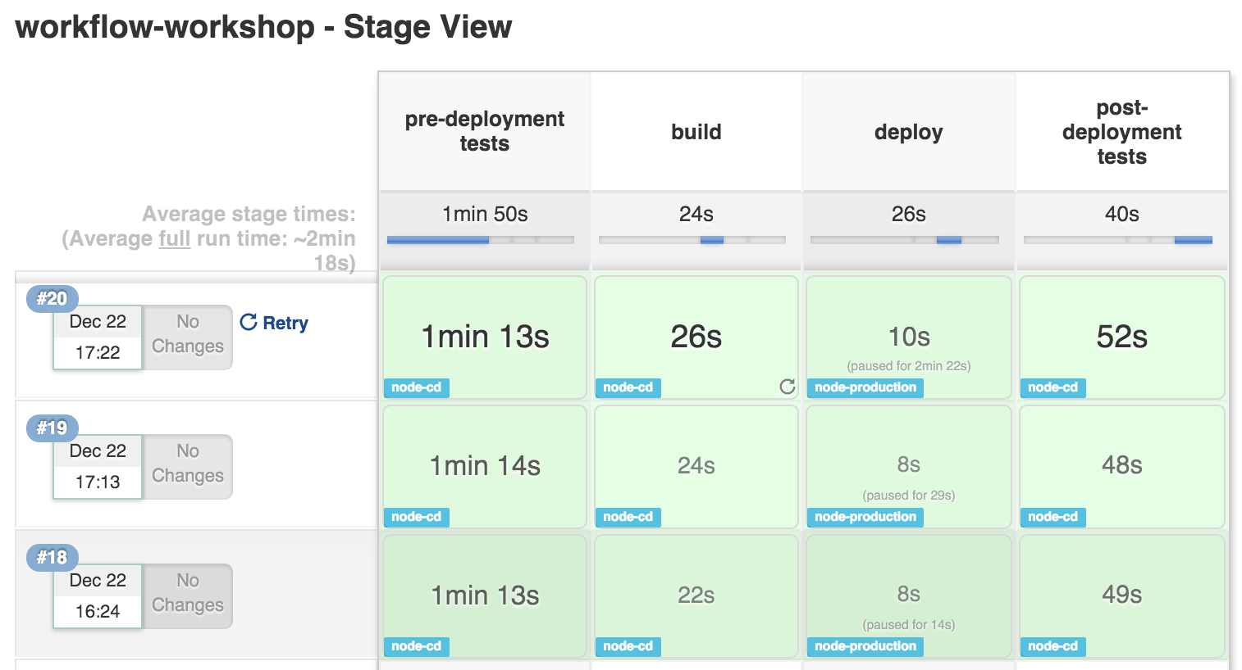
Workflow Stage View
Notes:
When you have complex builds pipelines, it is useful to be able to see the progress of each stage. To that end, Jenkins Enterprise includes an extended visualization of workflow build history on the index page of a flow project, under Stage View. (You can also click on Full Stage View to get a full-screen view.)
By adding Stage View to your Workflow jobs it allows users to easily identify the progress of each stage within the job.

Slide 76
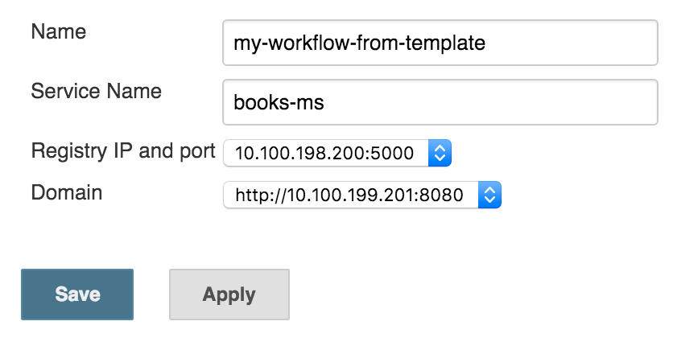
Workflow and Job Template
Task:
Convert the deployment workflow script into a template named my-template.
Replace service name (training-books-ms), Registry IP and port (10.100.198.200:5000) and domain (http://10.100.198.200:8081) with variables.
Create a new job called my-workflow-from-template

Slide 77
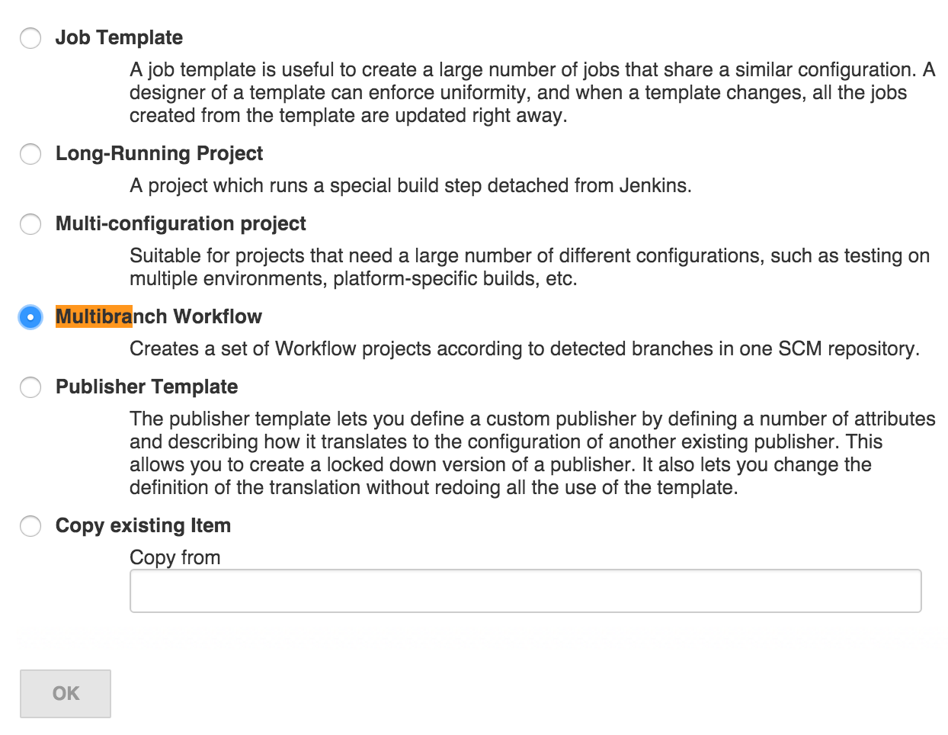
Multi-branch Workflow and Jenkinsfile
Notes:
Multi-branch Workflow job type allows us to use Jenkinsfile as the source of the Workflow script. Once the job is created, Jenkins will scan the code repository and create sub-projects for each branch. Each of those sub-projects will run the Workflow script defined in the Jenkinsfile. Having the ability to use a different Jenkinsfile depending on the branch, allows us to fine tune the flow depending on a branch type. For example, the flow defined in Jenkinsfile in the master branch can perform the full delivery all the way until deployment to production. On the other hand, Jenkinsfile inside a feature branch could perform all kinds of testing but skip the deployment itself.
Create new job called "my-multibranch". Select "Multibranch Workflow" as the job type.

Slide 78
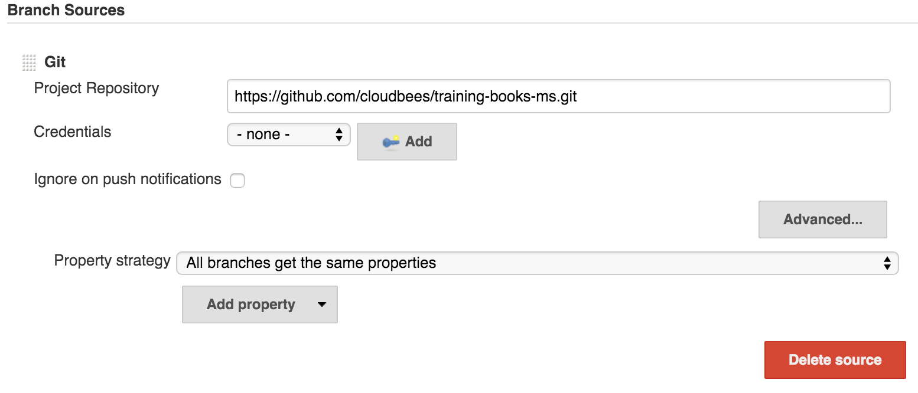
Multi-branch Workflow and Jenkinsfile
Notes:
Click the "Add Source" button, select "Git" and type "https://github.com/cloudbees/training-books-ms.git" as project repository. Once "Save" button is clicked, Jenkins will scan all branches and create sub-projects for all of them.

Slide 79
Multi-branch Workflow and Jenkinsfile
def serviceName = "training-books-ms" def registry = "10.100.198.200:5000" def flow node("cd") { git "https://github.com/cloudbees/${serviceName}.git" flow = load "/data/scripts/workflow-common.groovy" flow.runPreDeploymentTests(serviceName, registry) flow.build(serviceName, registry) } checkpoint "deploy" node("cd") { flow.deploy(serviceName, registry) flow.runPostDeploymentTests(serviceName, registry, "http://10.100.198.200:8081") }
Notes:
This is the content of the Jenkinsfile located in the master branch of the https://github.com/cloudbees/training-books-ms repository. Functionally, the result is the same as in the Workflow script we created earlier. However, there is a syntax difference. Unlike previous Workflow that was defined through a single script, this time we are loading functions from a separate script. This, together with Jenkinsfile placed in code repository, allows developers to define the flow for the own project and keep it in the repository together with the project code. By externalizing common functions inside a separate script we are able to avoid repetition and let developers focus on the flow itself.

Slide 80
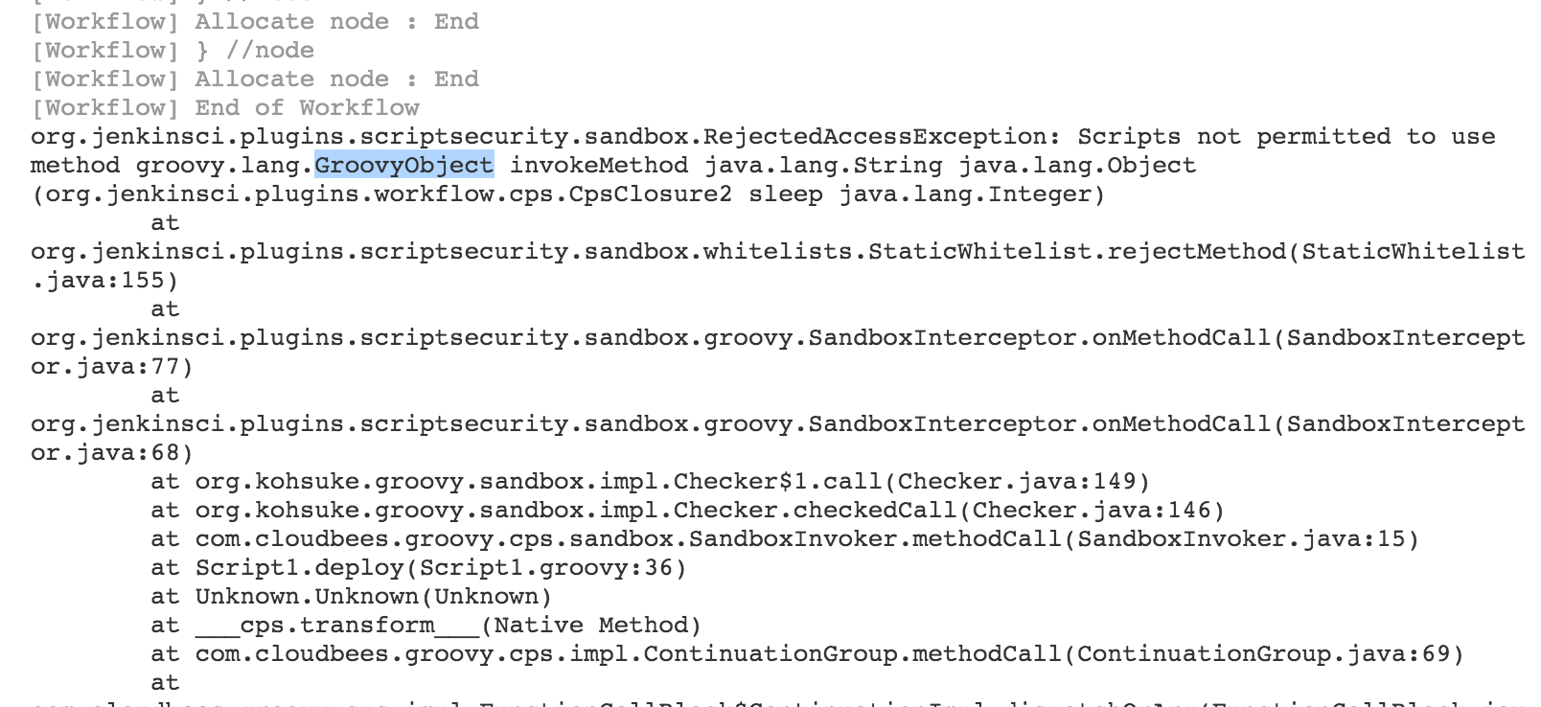
Multi-branch Workflow and Jenkinsfile
Notes:
When external scripts are used (in this example Jenkinsfile), Workflow runs with security restrictions. It will fail if it contains unauthorized instructions.

Slide 81
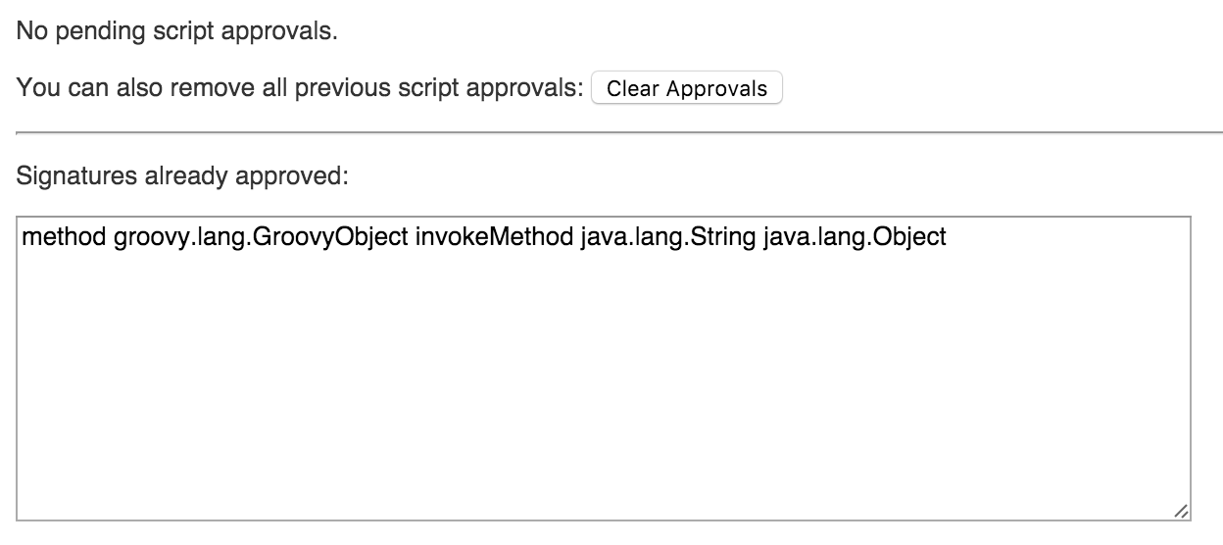
Multi-branch Workflow and Jenkinsfile
Notes:
All unapproved instructions will be listed in the "In-Process Script Approval" screen. Once approved, job can be re-run.

Slide 82
Workflow with Docker Day 4
Project Review

Slide 83
Project Review

Slide 84
Workflow with Docker Course Review

Slide 85
Course Review

Slide 86
Workflow with Docker Syllabus and References

Slide 87
Thank You !

